Slide 1
Spotify Data Analysis Project
Uncovering Insights on Song Popularity, Artist Trends, and Track Characteristics
Presented by :
Manobrath Dutta (Team Lead)
Shivam Kumar
Nisha Rana

Slide 2
Objective
Goal:
- Analyze the Spotify dataset to uncover insights on song popularity, artist trends, and track characteristics.
Build a Power BI dashboard to visualize music data insights.
Key Deliverables:
1. Data Cleaning
2. SQL Database Integration
3. Interactive Power BI Dashboard
4. Real-Time Updates
5. GitHub Repository

Slide 3
Project Workflow
Steps:
1. Dataset Processing
2. SQL Database Integration
3. Power BI Dashboard Creation
4. Real-Time Updates Configuration
5. Documentation and Sharing on GitHub

Slide 4
Dataset Processing
Tasks:
- Load dataset into a pandas Data Frame.
- Handle missing values and standardize formats (e.g., duration, popularity).
- Create derived columns (e.g., popularity tiers, categories).
- Save cleaned data for SQL loading.
Tools: Python, Pandas

Slide 5
SQL Database Integration
Tasks:
- Design database schema (e.g., song details, artist inforation , track metrics).
- Load cleaned data into SQL tables using Python.
- Ensure tables support advanced queries (e.g., popularity analysis).
Tools: SQL, Python (SQL Alchemy or pandas tosql)

Slide 6
Power BI Dashboard
Features:
- Visualizations:
- Top artists and songs by popularity.
- Trends in song features (e.g., duration, tempo, energy).
- Popular genres and their characteristics.
- Interactive filters for:
- Date ranges
- Artists
- Genres

Slide 7
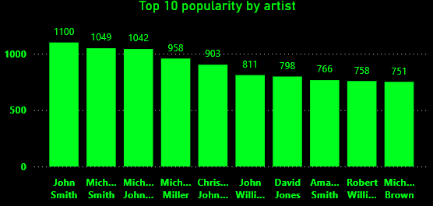
Top 10 Popularity By Artist
John Smith leads with the highest popularity score of 1100, followed closely by Michael Smith (1049) and Michael Johnson (1042).
The chart highlights the top 10 artists, showcasing a competitive distribution with Michael Brown (751) at the 10th spot.
The popularity variance suggests significant audience preferences and consistent releases by these artists.
This analysis can help identify key factors driving artist popularity, such as genre and engagement trends.

Slide 8
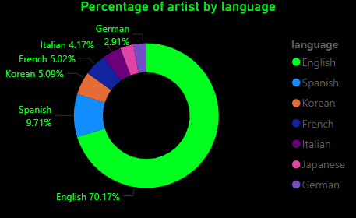
Percentage Of Artist By Language
The chart highlights the percentage distribution of artists by language, with English dominating at 70.17%, followed by Spanish at 9.71%. Other notable languages include Korean (5.09%), French (5.02%), and Italian (4.17%), reflecting cultural diversity. Smaller contributions from German (2.91%) and others suggest niche popularity. This data emphasizes the global reach of English while showcasing the influence of other languages in artistic expression.

Slide 9
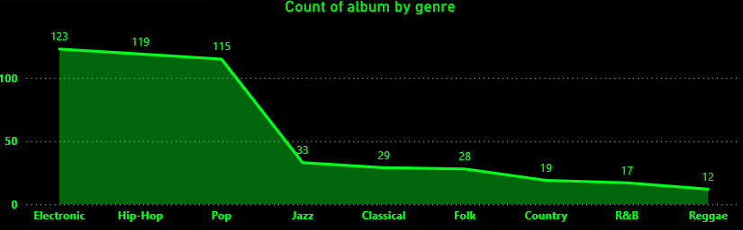
Count Of Album By Genre
The graph shows the count of albums by genre, with Electronic having the highest count at 123 albums.
Hip-Hop (119) and Pop (115) follow closely, showcasing their widespread popularity.
Less represented genres include Country (19), R&B (17), and Reggae (12), indicating niche preferences.
A steep decline is seen in genres like Jazz (33), Classical (29), and Folk (28).
The chart highlights the dominance of contemporary genres over traditional ones in album production.

Slide 10
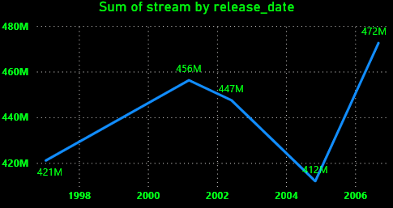
Sum of Stream By Release Date
The graph displays the sum of streams by release date over selected years.
Streams started at 421M in 1998 and peaked at 456M in 2000, showing consistent growth.
A slight dip occurred in 2002 with 447M streams, followed by a sharp decline to 412M in 2004.
Streams surged again to 472M in 2006, marking the highest value in the timeline.
The data indicates fluctuating streaming trends, with a significant recovery after 2004.

Slide 11
Real-Time Updates
Tasks:
- Configure Power BI to refresh periodically.
- Ensure SQL database updates sync with Power BI.
Benefits:
- Always up-to-date insights.
- Automated data integration.

Slide 12
GitHub Repository
Contents:
- Python Code: Data processing and SQL loading scripts.
- Documentation:
- Project overview
- Setup instructions
- Step-by-step process
- SQL Schema: Scripts for database creation and integrity rules.

Slide 13
Project Outcome
Expected Results:
- Comprehensive insights into Spotify music trends.
- Professional-grade Power BI dashboard.
- Scalable and reusable database and scripts.
Future Scope:
- Expand dataset with new music releases.
- Enhance dashboard with additional KPIs.

Slide 14
Thank You

